Slide 1
P56 - Benchmark Commercial AI product for Medical Imaging Services Provider
ISYS3888_TU15_02
Kiran Papalkar 490411205 kpap8603
Bronte Lee 490420056 blee6992
Benjamin Men 500401903 jmen0495
Zheyuan Zhang 500023392 zzha3548
Cailin Feldman 480439062 cfel2589
Andersen Liu 480022439 bliu3122(Other group name: SOFT3888_TU12_01(REMOTE), project name: P08 - WeBike)
Zichen Li 500174041 zili4471 (Other group name: SOFT3888_W16_02(REMOTE), project name: P25 - Travel plan and diary application)

Slide 2
Introduction of Project and Stakeholders
Introduction:
The basis of this project is in identifying CAD products to be used in tuberculosis detection, we will be crafting a recommendation report to present to ABC in order to identify the most appropriate product for their needs by analysing available technical and user data.
Stakeholders:
ABC
Dr. Xavier Ray (Chief Radiologist Information Officer)
Chuck To (Chief Technology Officer)
Our team
Simon Poon (Client)

Slide 3
Scope of the Project (Andersen + Zheyuan)
AI + radiologists = modern radiology practice
Performance = sensitivity + accuracy + validity + etc.
A better AI project = performance + UX
We will split the project into two subgroup- evaluate ai performance and user experience.
With effective communication and well arranged tasks, we will research ai for the medical imaging industry and give evaluation reports.
Notes:
Today AI products are widely used in radiology clinics. As medical technology companies develop, more and more technology products (AI) can detect TB. Then the question of which products can better serve radiologists becomes a question to be studied.
Different products have different performances (sensitivity, accuracy, validity, etc.), so we need to use a systematic review and meta-analysis to analyze which product is best. We also need to benchmark the different products to determine which product has more user experience advantages. Combining product performance and user experience, we recommend the most suitable products for our customers.

Slide 4
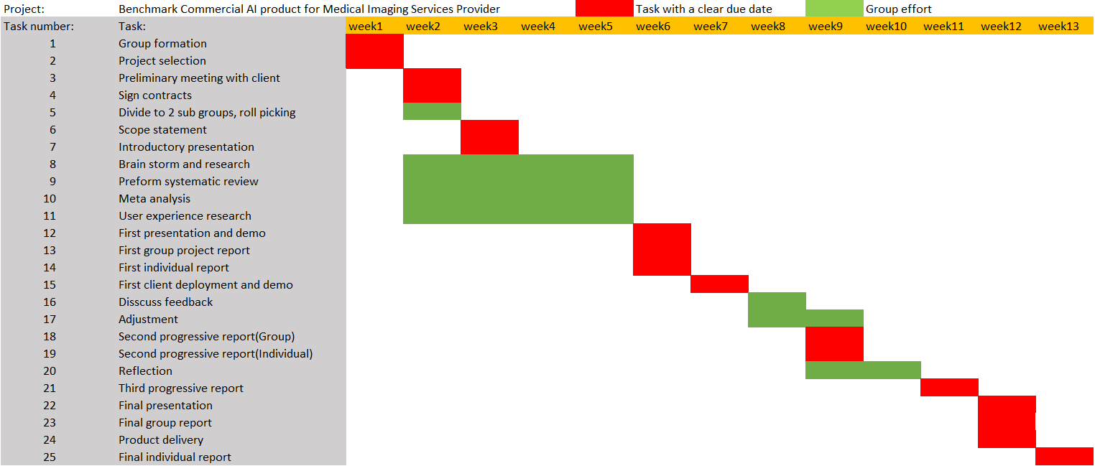
Timeline(Benjamin)

Slide 5
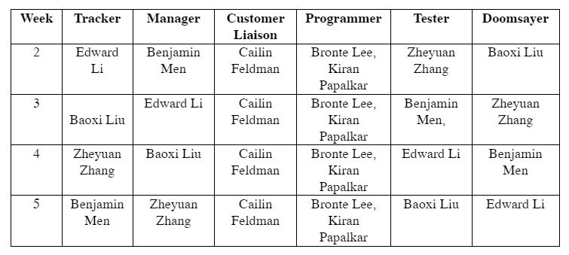
Member Responsibilities(Edward Li)
Customer Liaison: Cailin
Programmers: Bronte and Kiran
Tracker, Manager, Tester and Doomsayer: Rotate between the rest of the team members(Edward, Benjamin, Andersen and Zheyuan)

Slide 6
Expected outcomes and deliverables (Bronte Lee)
Outcomes
Benchmark AI products that diagnose TB using diagnostic test accuracy
Investigate user experience of AI products used for medical diagnosis and identify factors affecting user acceptance
Provide a recommendation of which product is best based on accuracy and user experience
Deliverables
Progress report and presentation:
Systematic review
Initial meta-analysis of diagnostic test accuracy and user experience
Final report and presentation:
Systematic review
Completed meta-analysis of diagnostic test accuracy and user experience
Discussion and recommendation of a product

